Slide 1
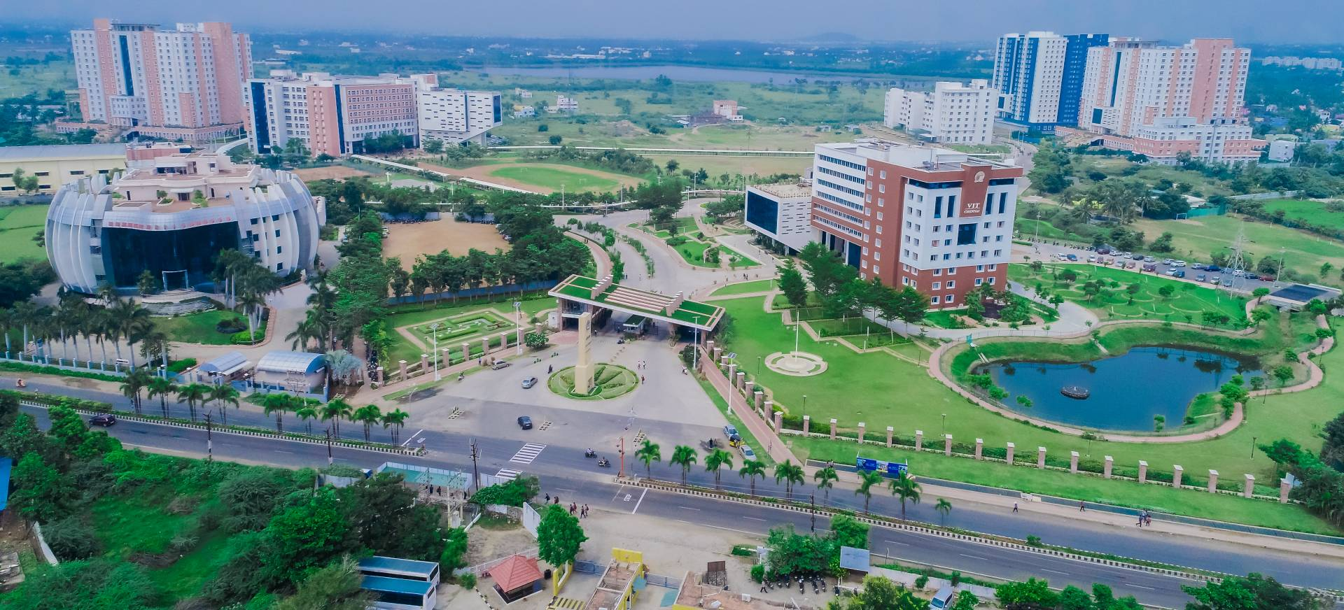
Image Processing
CSE4019
Object Detection using Selective Search & EdgeBoxes algorithm in OpenCV
Agnish Sahu
18BCE1023
Shambhavi Rai
18BCE1304
VIT CHENNAI

Slide 2
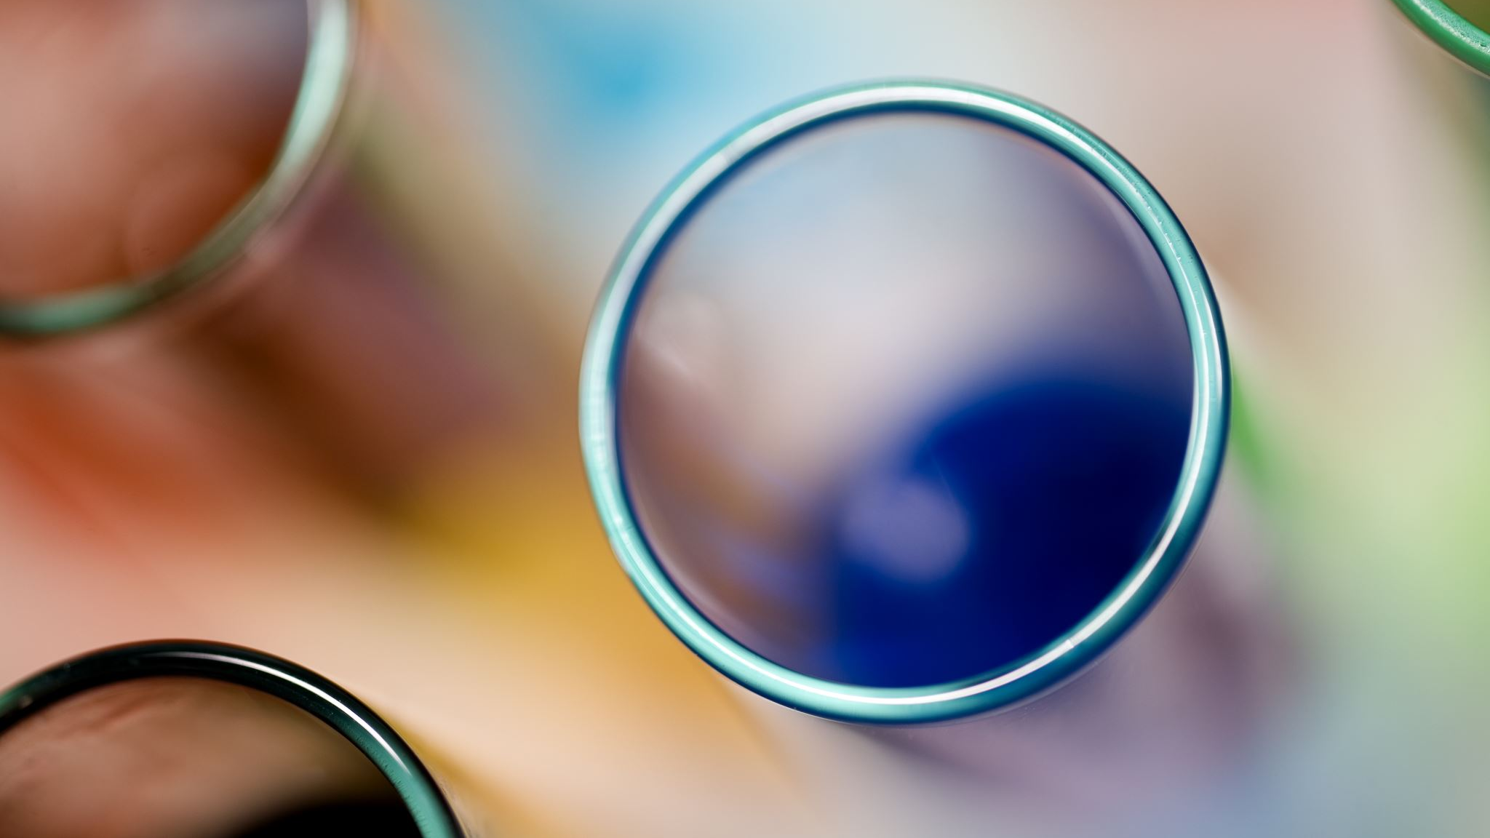
OBJECTIVE
This project aims to experiment with two methods (Selective Search and EdgeBoxes) to generate object proposals. We used OpenCV library to test these methods on some sample color images.

Slide 3

ABSTRACT
Here, in this project we are aiming to detect and track objects by building an object detector. There had been quite a research in this topic but what we want to achieve is to compare and contrast the performances of two algorithms. These two algorithms are the Selective Search algorithm and the Edge Boxes algorithm.

Slide 4
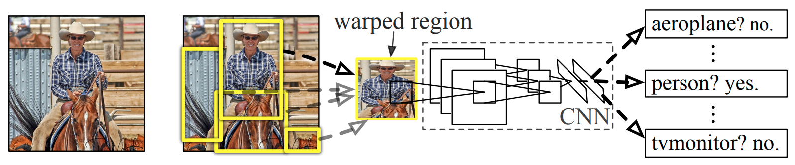
SELECTIVE SEARCH ALGORITHM
Selective Search is a region proposal algorithm used in object detection. It is designed to be fast with a very high recall. It is based on computing hierarchical grouping of similar regions based on color, texture, size and shape compatibility.
Selective Search is widely used in early state-of-the-art architecture such as R-CNN, Fast R-CNN etc. However, Due to number of windows it processed, it takes anywhere from 1.8 to 3.7 seconds (Selective Search Fast) to generate region proposal which is not good enough for a real-time object detection system.
This Photo by Unknown author is licensed under CC BY-SA-NC.

Slide 5
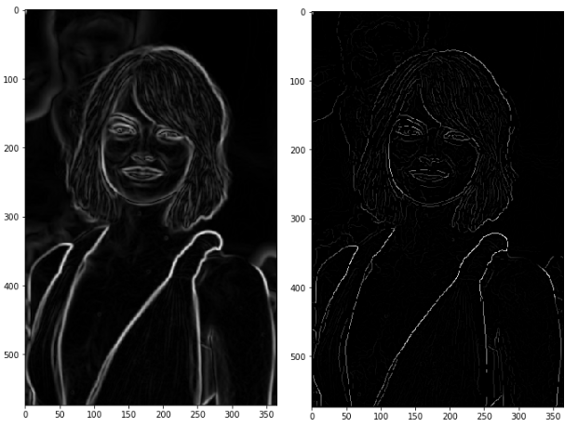
EDGEBOXES ALGORITHM
EdgeBoxes is an approach for generating object bounding box proposals directly from edges. Similar to segments, edges provide a simplified but informative representation of an image.
The main insight behind the method is the observation: the number of contours wholly enclosed by a bounding box is indicative of the likelihood of the box containing an object. We say a contour is wholly enclosed by a box if all edge pixels belonging to the contour lie within the interior of the box. Edges tend to correspond to object boundaries, and as such boxes that tightly enclose a set of edges are likely to contain an object. However, some edges that lie within an object’s bounding box may not be part of the contained object. Specifically, edge pixels that belong to contours straddling the box’s boundaries are likely to correspond to objects or structures that lie outside the box.

Slide 6
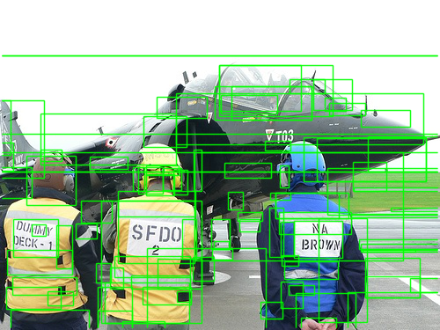
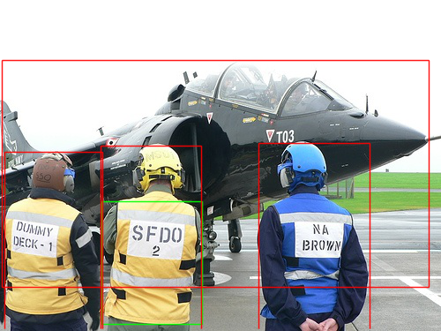
SELECTIVE SEARCH
Color Strategy Total proposals = 273 Number of Ground Truth Boxes = 4 Number of Qualified Boxes with IOU > 0.5 = 1 Qualified Boxes = [[115, 228, 229, 367]] Number of final boxes = 1 Final boxes = [[115, 228, 229, 367]] Recall = 0.25

Slide 7
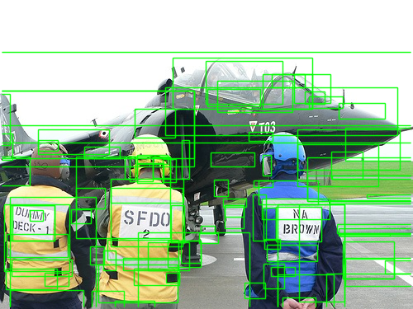
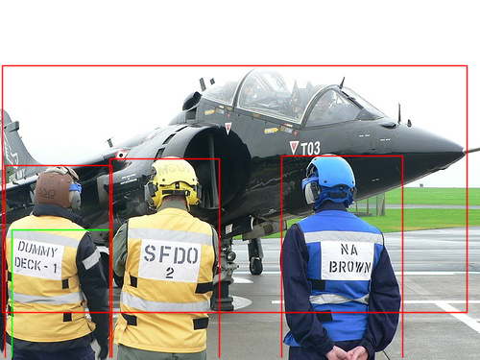
SELECTIVE SEARCH
All Strategy Total proposals = 284 Number of Ground Truth Boxes = 4 Number of Qualified Boxes with IOU > 0.5 = 1 Qualified Boxes = [[12, 239, 116, 375]] Number of final boxes = 1 Final boxes = [[12, 239, 116, 375]] Recall = 0.25

Slide 8
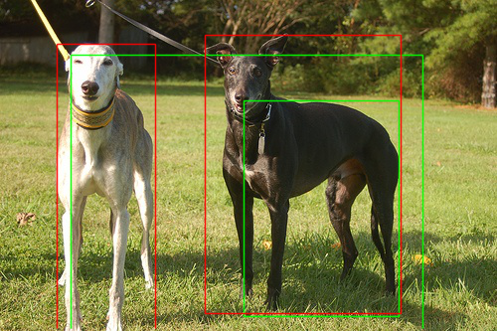
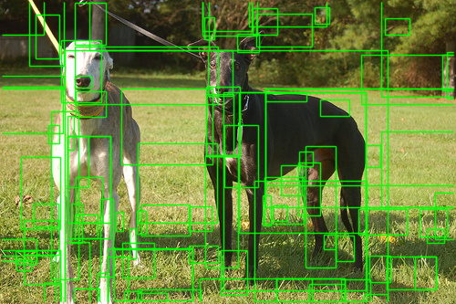

SELECTIVE SEARCH
Color Strategy Total proposals = 250 Number of Ground Truth Boxes = 2 Number of Qualified Boxes with IOU > 0.5 = 2 Qualified Boxes = [[245, 101, 401, 318], [71, 55, 425, 333]] Number of final boxes = 1 Final boxes = [[245, 101, 401, 318]] Recall = 0.5

Slide 9
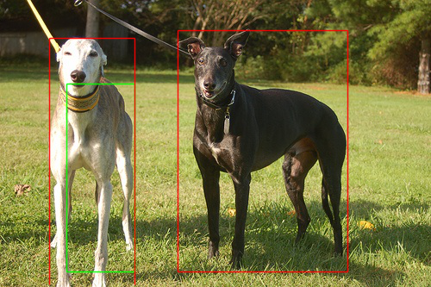
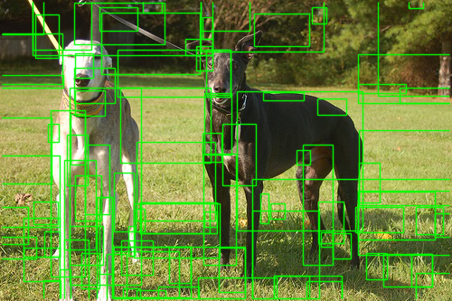
SELECTIVE SEARCH
All Strategy Total proposals = 266 Number of Ground Truth Boxes = 2 Number of Qualified Boxes with IOU > 0.5 = 1 Qualified Boxes = [[77, 97, 156, 315]] Number of final boxes = 1 Final boxes = [[77, 97, 156, 315]] Recall = 0.5

Slide 10
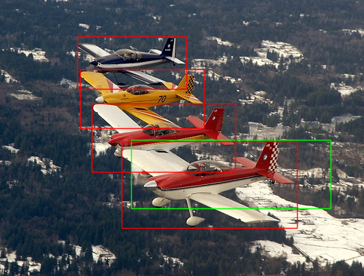
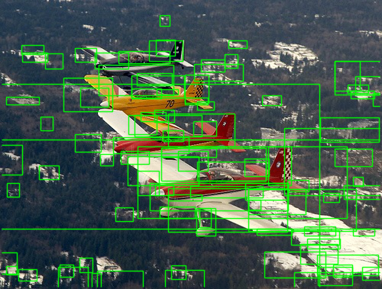

SELECTIVE SERACH
Color Strategy Total proposals = 252 Number of Ground Truth Boxes = 4Number of Qualified Boxes with IOU > 0.5 = 1 Qualified Boxes = [[180, 192, 454, 286]] Number of final boxes = 1 Final boxes = [[180, 192, 454, 286]] Recall = 0.25

Slide 11
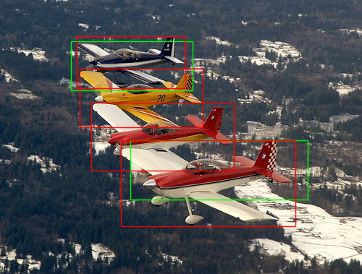
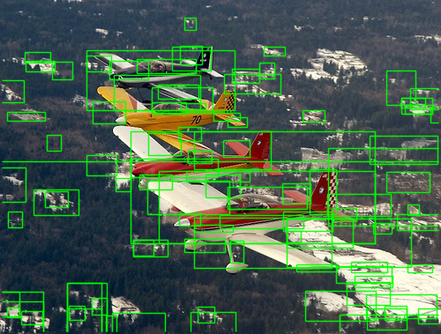
SELECTIVE SEARCH
All Strategy Total proposals = 282 Number of Ground Truth Boxes = 4 Number of Qualified Boxes with IOU > 0.5 = 2 Qualified Boxes = [[98, 57, 266, 125], [180, 194, 425, 276]] Number of final boxes = 2 Final boxes = [[98, 57, 266, 125], [180, 194, 425, 276]] Recall = 0.5

Slide 12
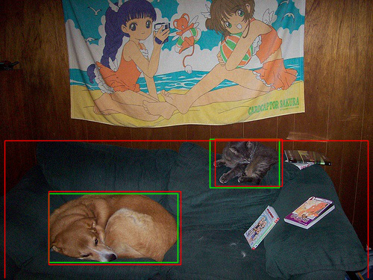
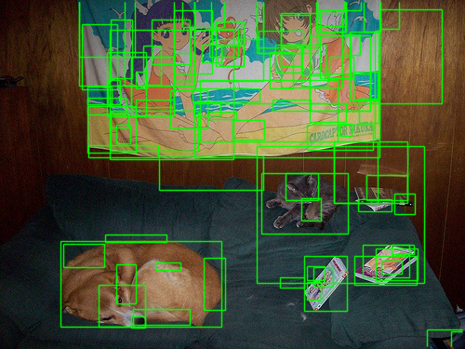
SELECTIVE SEARCH
Color Strategy Total proposals = 167 Number of Ground Truth Boxes = 3 Number of Qualified Boxes with IOU > 0.5 = 2 Qualified Boxes = [[65, 259, 238, 351], [281, 186, 374, 251]] Number of final boxes = 2 Final boxes = [[65, 259, 238, 351], [281, 186, 374, 251]] Recall = 0.6666666666666666

Slide 13
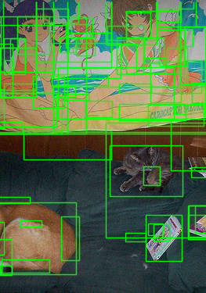
SELECTIVE SEARCH
All Strategy Total proposals = 182 Number of Ground Truth Boxes = 3 Number of Qualified Boxes with IOU > 0.5 = 2 Qualified Boxes = [[65, 259, 238, 351], [281, 186, 374, 251]] Number of final boxes = 2 Final boxes = [[65, 259, 238, 351], [281, 186, 374, 251]] Recall = 0.6666666666666666

Slide 14
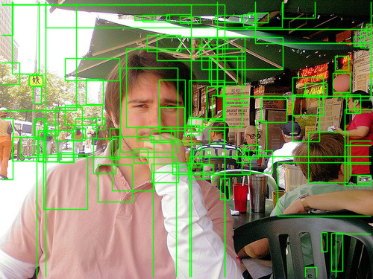
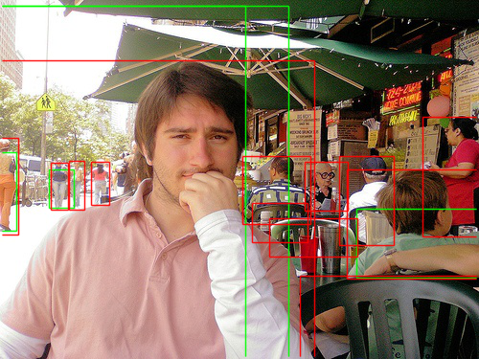
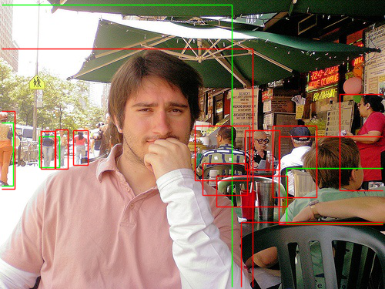
SELECTIVE SEARCH
Color Strategy Total proposals = 334 Number of Ground Truth Boxes = 13 Number of Qualified Boxes with IOU > 0.5 = 6 Qualified Boxes = [[0, 0, 500, 375], [0, 6, 301, 375], [0, 6, 256, 375], [372, 218, 500, 290], [0, 159, 17, 241], [51, 177, 77, 217]] Number of final boxes = 4 Final boxes = [[0, 6, 301, 375], [372, 218, 500, 290], [0, 159, 17, 241], [51, 177, 77, 217]] Recall = 0.3076923076923077

Slide 15
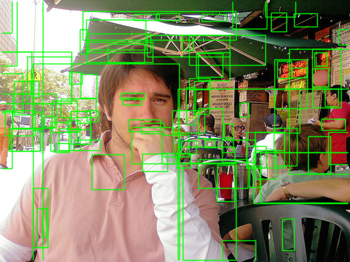
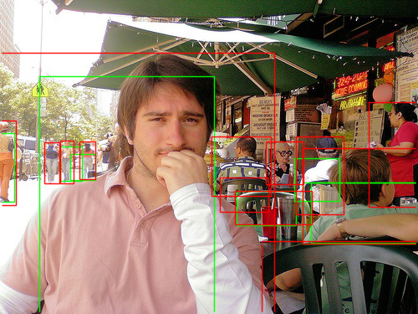
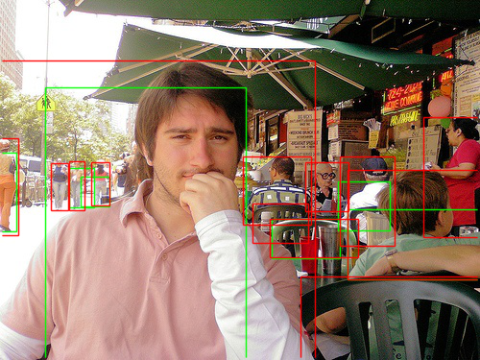
SELECTIVE SEARCH
All Strategy Total proposals = 354 Number of Ground Truth Boxes = 13 Number of Qualified Boxes with IOU > 0.5 = 8 Qualified Boxes = [[283, 228, 354, 269], [47, 91, 256, 375], [362, 218, 500, 291], [372, 218, 500, 290], [352, 189, 406, 240], [0, 159, 17, 241], [84, 184, 114, 215], [72, 175, 98, 216]] Number of final boxes = 7 Final boxes = [[283, 228, 354, 269], [47, 91, 256, 375], [362, 218, 500, 291], [352, 189, 406, 240], [0, 159, 17, 241], [84, 184, 114, 215], [72, 175, 98, 216]] Recall = 0.5384615384615384

Slide 16
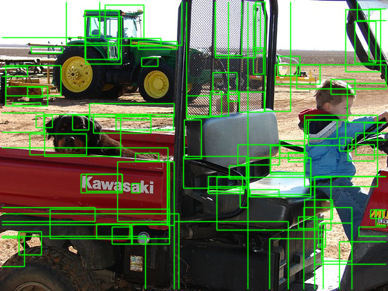
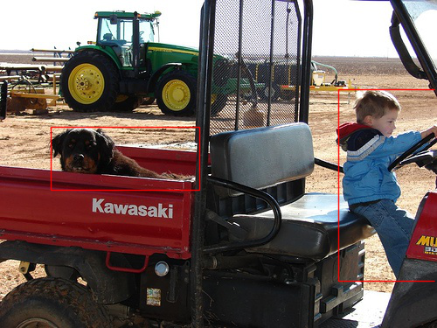
SELECTIVE SEARCH
Color Strategy Total proposals = 293 Number of Ground Truth Boxes = 2 Number of Qualified Boxes with IOU > 0.5 = 0 Qualified Boxes = [] Number of final boxes = 0 Final boxes = [] Recall = 0.0

Slide 17


SELECTIVE SEARCH
All Strategy Total proposals = 318 Number of Ground Truth Boxes = 2 Number of Qualified Boxes with IOU > 0.5 = 1 Qualified Boxes = [[382, 101, 500, 240]] Number of final boxes = 1 Final boxes = [[382, 101, 500, 240]] Recall = 0.5

Slide 18
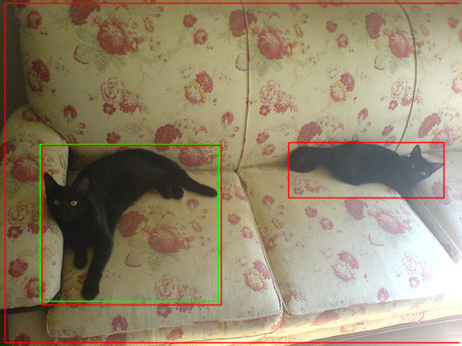
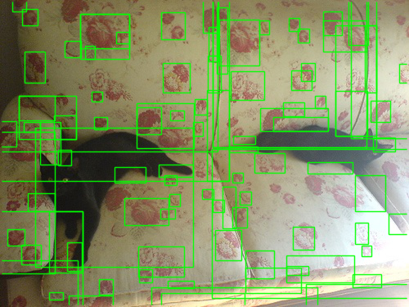
SELECTIVE SEARCH
Color Strategy Total proposals = 151 Number of Ground Truth Boxes = 3 Number of Qualified Boxes with IOU > 0.5 = 1 Qualified Boxes = [[43, 156, 236, 326]] Number of final boxes = 1 Final boxes = [[43, 156, 236, 326]] Recall = 0.3333333333333333

Slide 19

SELECTIVE SEARCH
All Strategy Total proposals = 169 Number of Ground Truth Boxes = 3 Number of Qualified Boxes with IOU > 0.5 = 1 Qualified Boxes = [[43, 156, 236, 326]] Number of final boxes = 1 Final boxes = [[43, 156, 236, 326]] Recall = 0.3333333333333333

Slide 20
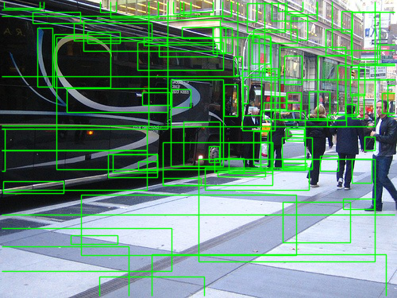
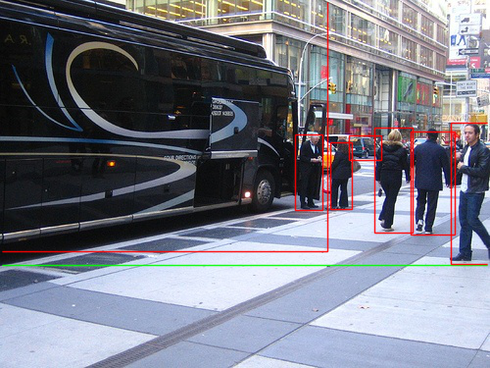
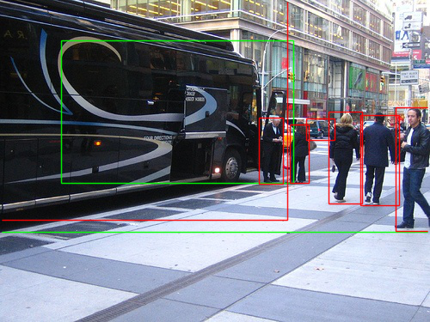
SELECTIVE SEARCH
Color Strategy Total proposals = 339 Number of Ground Truth Boxes = 7 Number of Qualified Boxes with IOU > 0.5 = 2 Qualified Boxes = [[0, 0, 500, 270], [71, 47, 341, 213]] Number of final boxes = 1 Final boxes = [[0, 0, 500, 270]] Recall = 0.14285714285714285

Slide 21
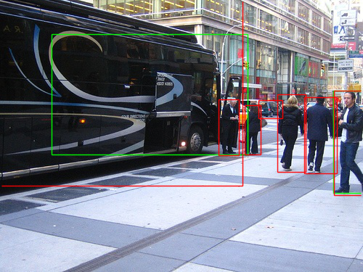
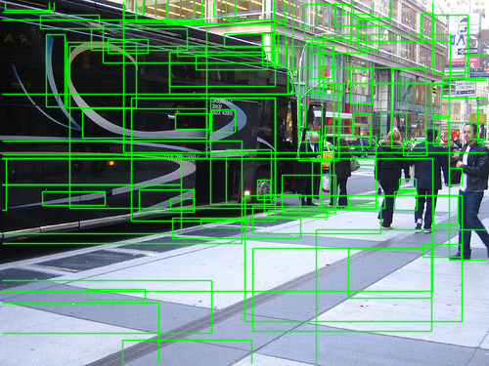
SELECTIVE SEARCH
All Strategy Total proposals = 358 Number of Ground Truth Boxes = 7 Number of Qualified Boxes with IOU > 0.5 = 2 Qualified Boxes = [[71, 47, 341, 213], [459, 125, 500, 266]] Number of final boxes = 2 Final boxes = [[71, 47, 341, 213], [459, 125, 500, 266]] Recall = 0.2857142857142857

Slide 22
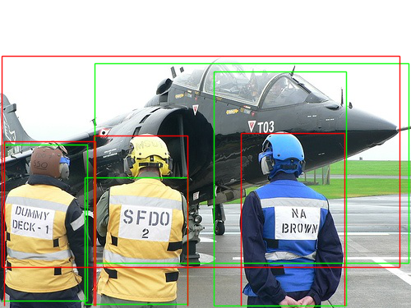
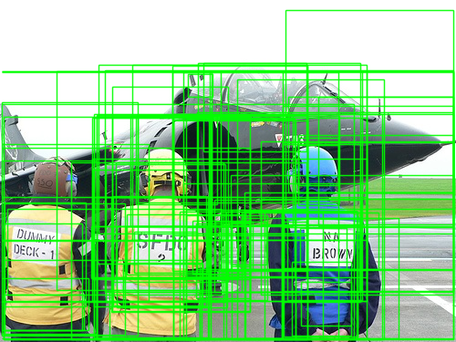
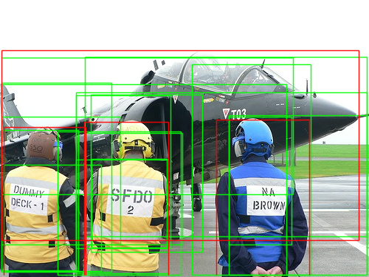
EDGEBOXES
Number of Ground Truth Boxes = 4 Number of Qualified Boxes with IOU > 0.5 = 17 Qualified Boxes = [[310, 156, 497, 372], [260, 87, 421, 372], [310, 158, 395, 331], [124, 215, 226, 335], [103, 216, 228, 370], [103, 129, 231, 336], [123, 128, 274, 341], [78, 178, 245, 372], [116, 180, 247, 331], [5, 223, 137, 367], [2, 112, 151, 368], [1, 176, 106, 366], [1, 158, 163, 331], [103, 125, 497, 373], [1, 114, 388, 373], [115, 77, 497, 320], [1, 78, 397, 263]] Number of final boxes = 4 Final boxes = [[260, 87, 421, 372], [103, 216, 228, 370], [1, 176, 106, 366], [115, 77, 497, 320]] Recall = 1.0

Slide 23
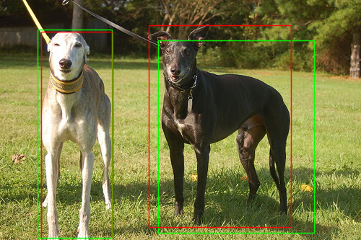
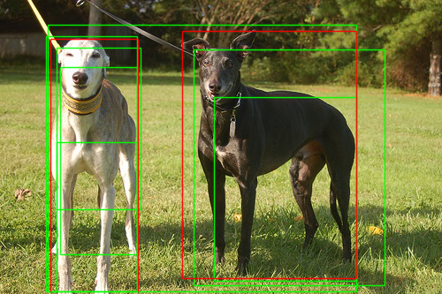
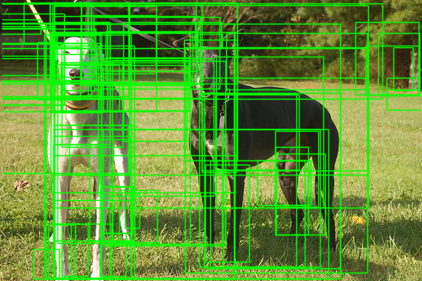
EDGEBOXES
Number of Ground Truth Boxes = 2 Number of Qualified Boxes with IOU > 0.5 = 7 Qualified Boxes = [[52, 41, 155, 330], [68, 76, 155, 288], [64, 161, 155, 333], [64, 54, 159, 237], [54, 28, 403, 330], [219, 56, 435, 323], [242, 110, 403, 318]] Number of final boxes = 2 Final boxes = [[52, 41, 155, 330], [219, 56, 435, 323]] Recall = 1.0

Slide 24
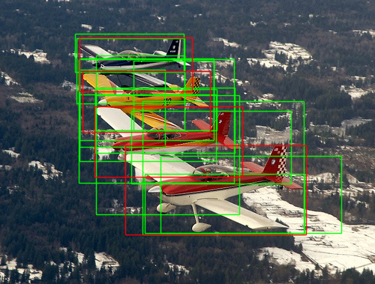
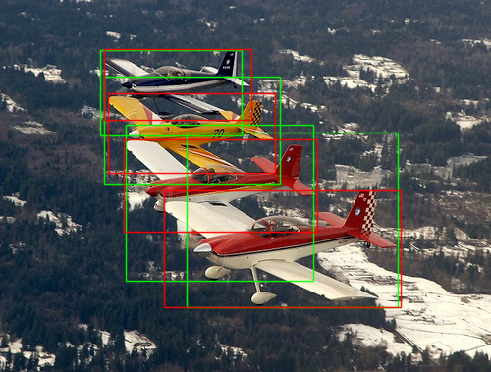
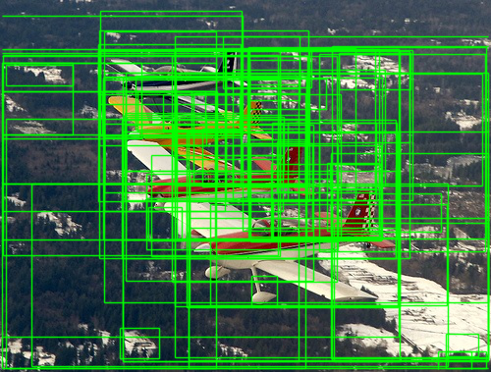
EDGEBOXES
Number of Ground Truth Boxes = 4 Number of Qualified Boxes with IOU > 0.5 = 15 Qualified Boxes = [[102, 51, 246, 138], [100, 45, 245, 96], [106, 78, 285, 187], [128, 74, 246, 174], [106, 93, 220, 196], [178, 81, 285, 174], [127, 119, 289, 174], [105, 79, 312, 244], [127, 117, 313, 204], [128, 127, 319, 286], [175, 148, 388, 245], [106, 126, 288, 215], [190, 135, 405, 313], [193, 232, 406, 311], [214, 208, 455, 311]] Number of final boxes = 4 Final boxes = [[102, 51, 246, 138], [106, 78, 285, 187], [128, 127, 319, 286], [190, 135, 405, 313]] Recall = 1.0

Slide 25
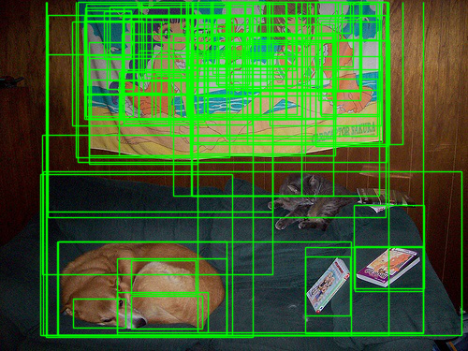
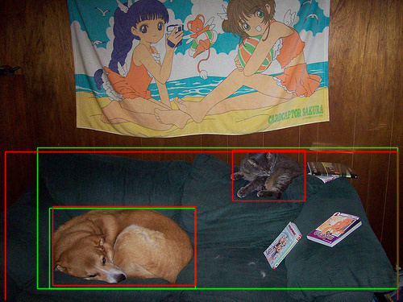
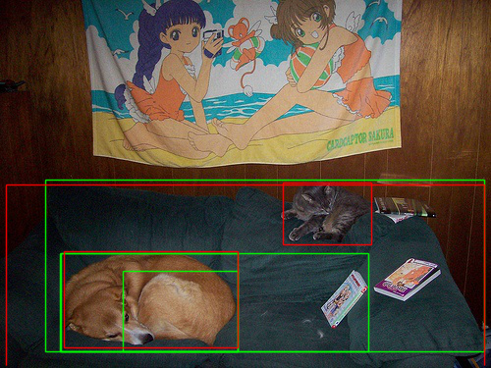
EDGEBOXES
Number of Ground Truth Boxes = 3 Number of Qualified Boxes with IOU > 0.5 = 4 Qualified Boxes = [[61, 258, 242, 358], [125, 276, 242, 358], [62, 258, 375, 358], [46, 183, 493, 358]] Number of final boxes = 2 Final boxes = [[61, 258, 242, 358], [46, 183, 493, 358]] Recall = 0.6666666666666666

Slide 26
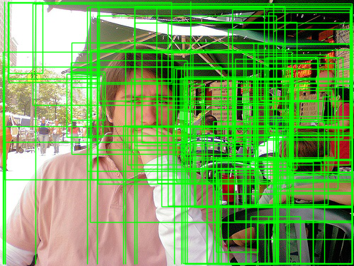
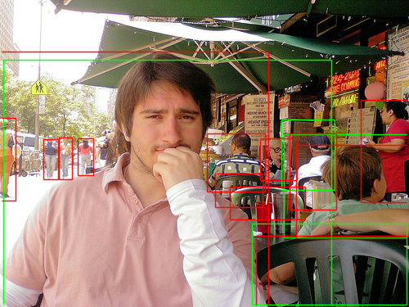
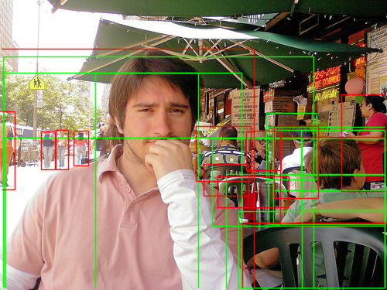
EDGEBOXES
Number of Ground Truth Boxes = 13 Number of Qualified Boxes with IOU > 0.5 = 12 Qualified Boxes = [[292, 225, 497, 373], [308, 273, 497, 372], [4, 73, 405, 375], [7, 178, 390, 375], [5, 94, 256, 375], [123, 94, 312, 375], [347, 164, 499, 290], [274, 179, 497, 292], [389, 168, 497, 271], [353, 226, 500, 290], [353, 168, 500, 246], [344, 146, 409, 232]] Number of final boxes = 4 Final boxes = [[308, 273, 497, 372], [4, 73, 405, 375], [347, 164, 499, 290], [344, 146, 409, 232]] Recall = 0.3076923076923077

Slide 27
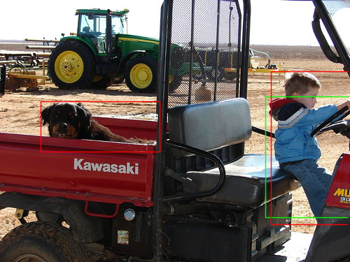


EDGEBOXES
Number of Ground Truth Boxes = 2 Number of Qualified Boxes with IOU > 0.5 = 4 Qualified Boxes = [[384, 137, 495, 253], [391, 155, 500, 375], [379, 138, 500, 311], [306, 97, 497, 308]] Number of final boxes = 1 Final boxes = [[379, 138, 500, 311]] Recall = 0.5

Slide 28



EDGEBOXES
Number of Ground Truth Boxes = 3 Number of Qualified Boxes with IOU > 0.5 = 8 Qualified Boxes = [[27, 128, 228, 372], [292, 146, 459, 212], [26, 24, 495, 369], [6, 7, 295, 337], [25, 129, 452, 372], [196, 9, 493, 368], [8, 64, 389, 334], [99, 78, 493, 334]] Number of final boxes = 3 Final boxes = [[27, 128, 228, 372], [292, 146, 459, 212], [26, 24, 495, 369]] Recall = 1.0

Slide 29



EDGEBOXES
Number of Ground Truth Boxes = 7 Number of Qualified Boxes with IOU > 0.5 = 12 Qualified Boxes = [[1, 7, 432, 282], [4, 9, 283, 166], [3, 8, 284, 264], [44, 7, 382, 172], [66, 8, 344, 229], [1, 45, 269, 217], [466, 141, 494, 262], [418, 134, 459, 243], [389, 138, 459, 245], [379, 139, 438, 245], [364, 156, 417, 240], [332, 155, 365, 211]] Number of final boxes = 5 Final boxes = [[3, 8, 284, 264], [466, 141, 494, 262], [418, 134, 459, 243], [379, 139, 438, 245], [332, 155, 365, 211]] Recall = 0.7142857142857143

Slide 30

Github link:
https://github.com/theShambhaviRai/Object-detection-using-EdgeBoxes-and-Selective-Search_Algorithm

Slide 31

Video demonstration link:
https://drive.google.com/file/d/1fPTEmeAVRIaNQhIWgEgYYaYEDGUN-gSR/view

Slide 32
THANKYOU

